Slide 1
ECE 884 Deep Learning Systems
Lecture 1: Introduction

Slide 2
Self introduction
Dr. Mi Zhang, Associate Professor of Electrical and Computer Engineering
Research Areas:
AI + Mobile Computing, Internet of Things == Artificial Intelligent of Things
AI for Healthcare Applications

Slide 3
Your turn
Major?
Master or PhD Student? Which Year?
If PhD, what is your research area?
Are you familiar with linear algebra, probability, and statistics?
Do you have the basic knowledge in machine learning or pattern recognition?
Do you have a solid programming background? If so, in which language?
Do you have any experience in building systems? (e.g., mobile apps, ARMs, robots, distributed systems)
What do you want to learn from this course?

Slide 4
Class Info
Tu Th: 10:20 am to 11:40 pm
Zoom: https://msu.zoom.us/j/96813594261 (Passcode: 679307)
Course Website: Desire2Learn (D2L) website (https://d2l.msu.edu/)
Office Hours: Tu Th: 11:40 am - 12:30 pm or by appointment

Slide 5
Prerequisites
Familiar with linear algebra, probability, and statistics.
Have the basic knowledge in machine learning or pattern recognition.
Solid in programming skills and python.
Have the basic knowledge in computer systems.

Slide 6

Optional Textbook
Deep Learning
An MIT Press book
Ian Goodfellow and Yoshua Bengio and Aaron Courville

Slide 7

Programming Platform
Google Colab: https://colab.research.google.com/notebooks/intro.ipynb

Slide 8
Prerequisites
Familiar with linear algebra, probability, and statistics.
Have the basic knowledge in machine learning or pattern recognition.
Solid in programming skills and python.
Have the basic knowledge in computer systems.

Slide 9



What this course is about
Deep Neural Networks
Mobile / IoT Systems

Slide 10
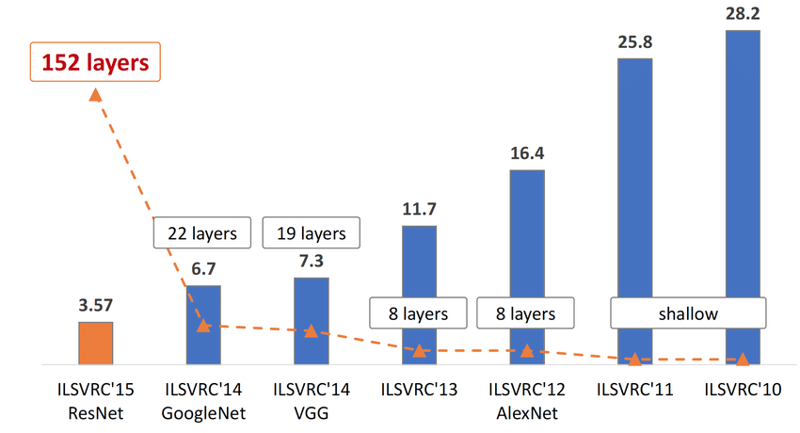
Section 1: Basics of Deep Neural Networks

Slide 11
Section 1: Basics of Deep Neural Networks
Convolutional Neural Networks

Slide 12
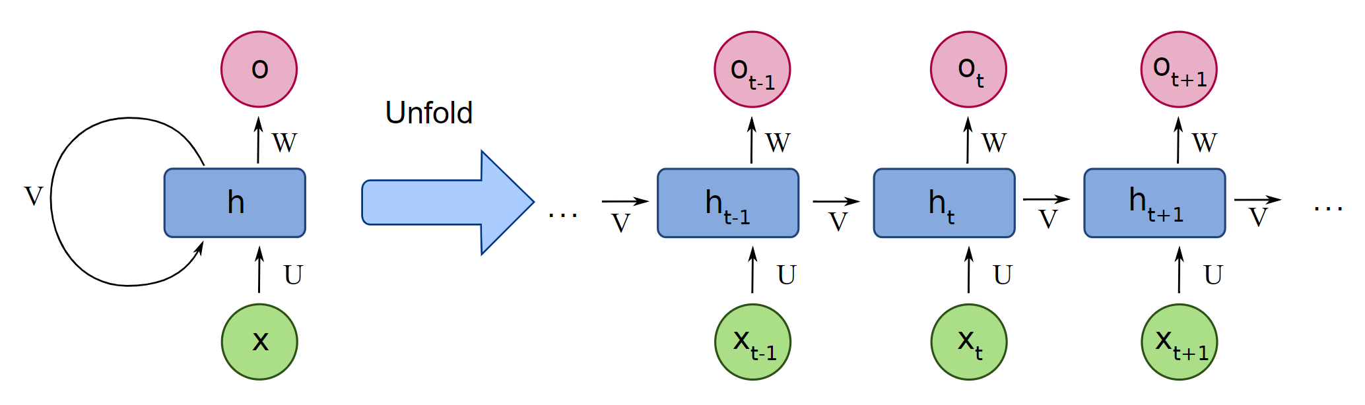
Section 1: Basics of Deep Neural Networks
Recurrent Neural Networks

Slide 13
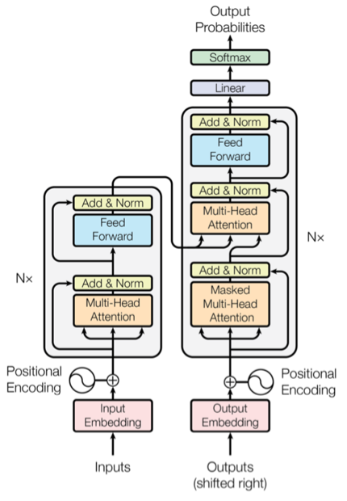
Section 1: Basics of Deep Neural Networks
Transformers

Slide 14
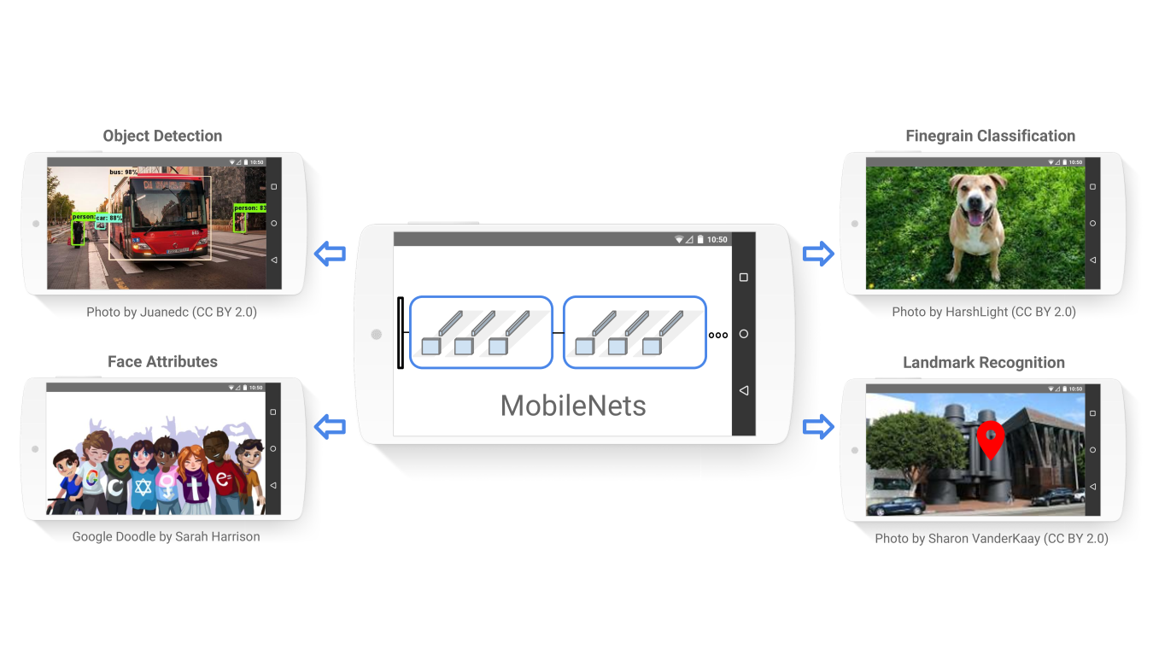
Section 1: Basics of Deep Neural Networks
MobileNet

Slide 15
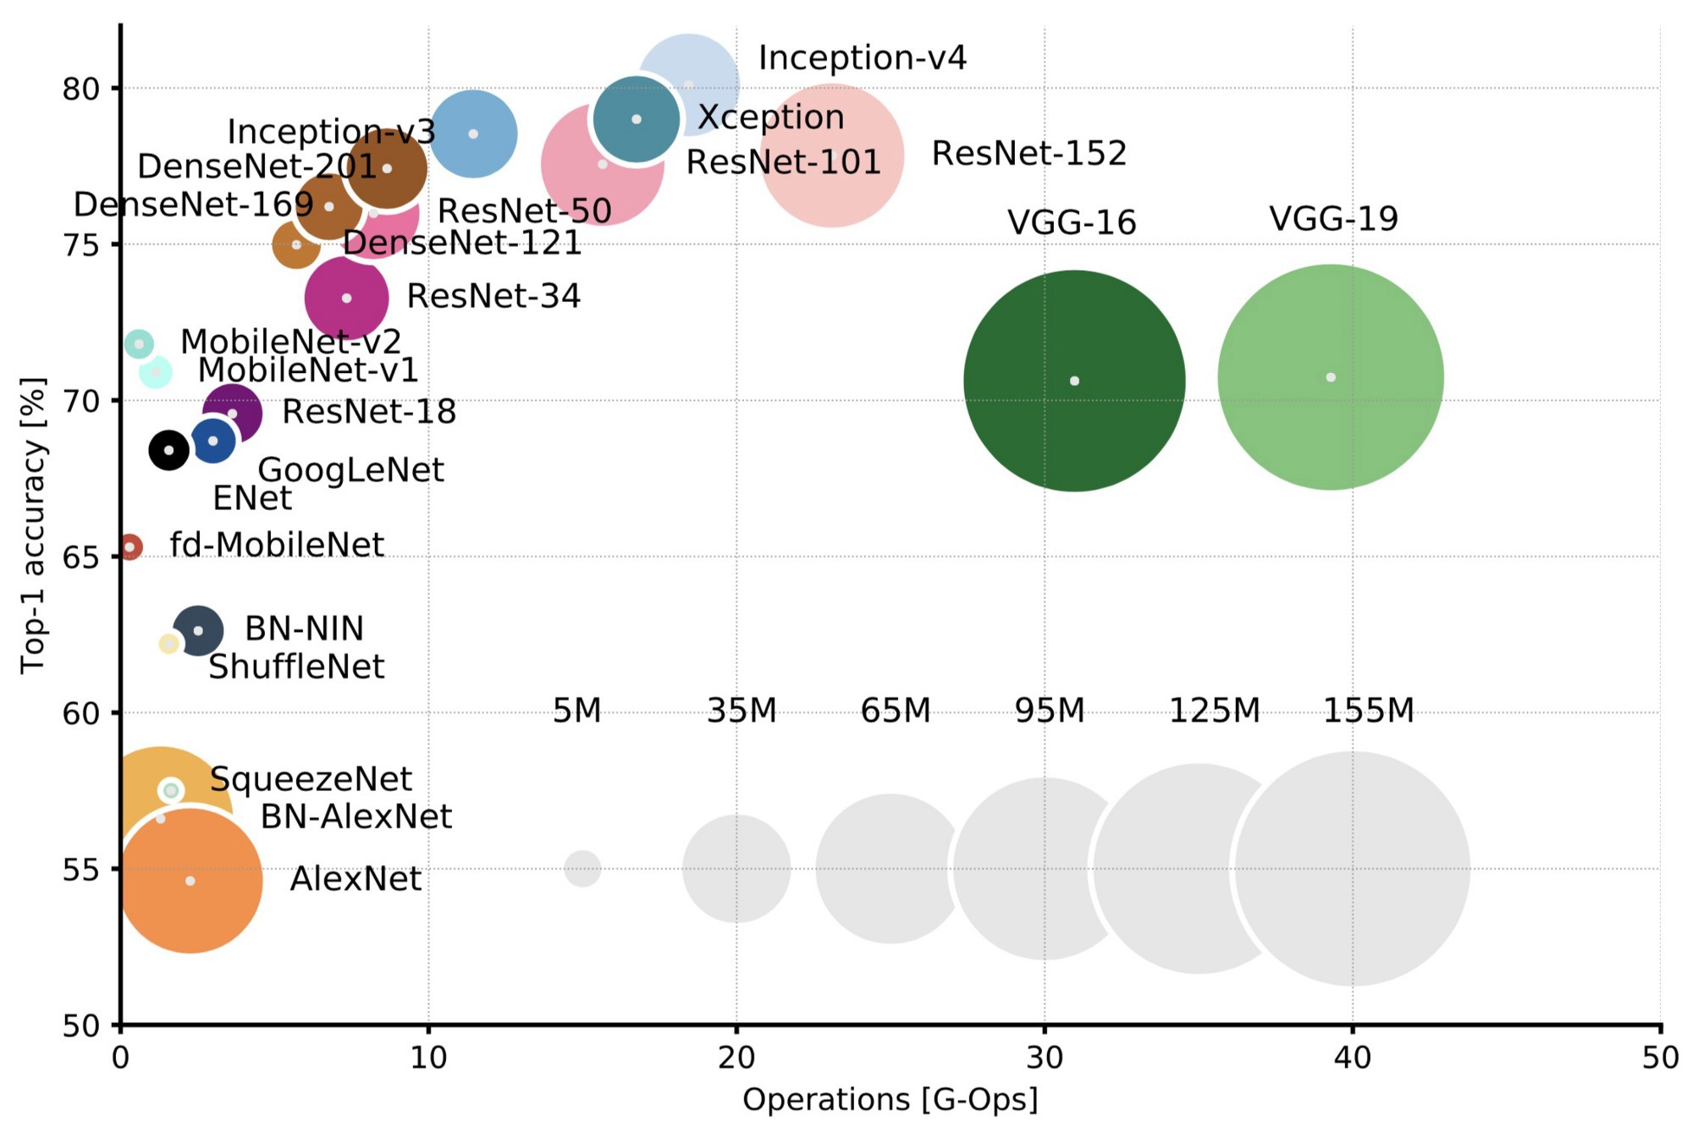
Section 2: Modern Deep Learning Systems
Efficient Deep Learning

Slide 16
Section 2: Modern Deep Learning Systems
Adaptive Deep Learning

Slide 17
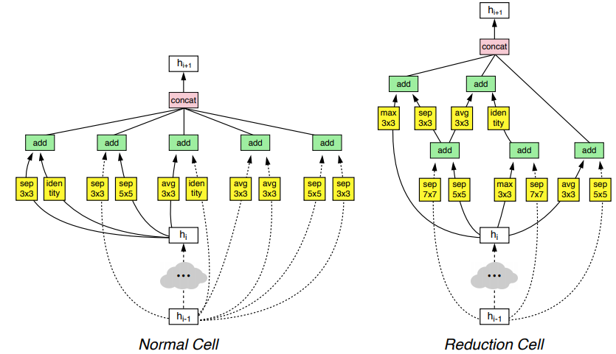
Section 2: Modern Deep Learning Systems
Automated
Machine Learning

Slide 18
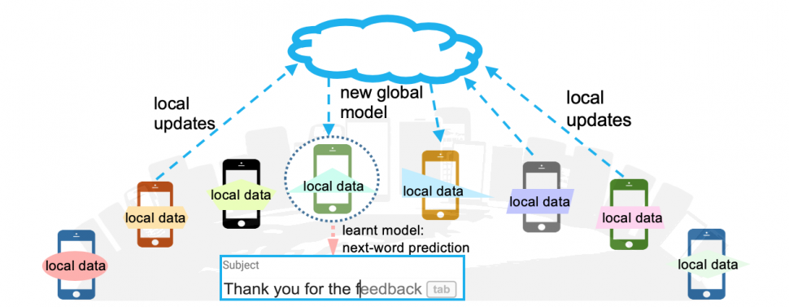
Section 2: Modern Deep Learning Systems
Federated Learning

Slide 19
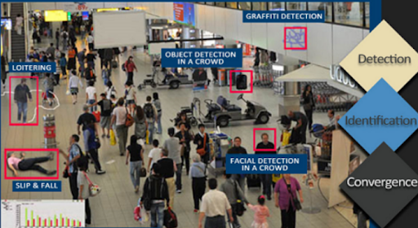
Section 3: Applications of Deep Learning Systems
Video Analytics Systems

Slide 20
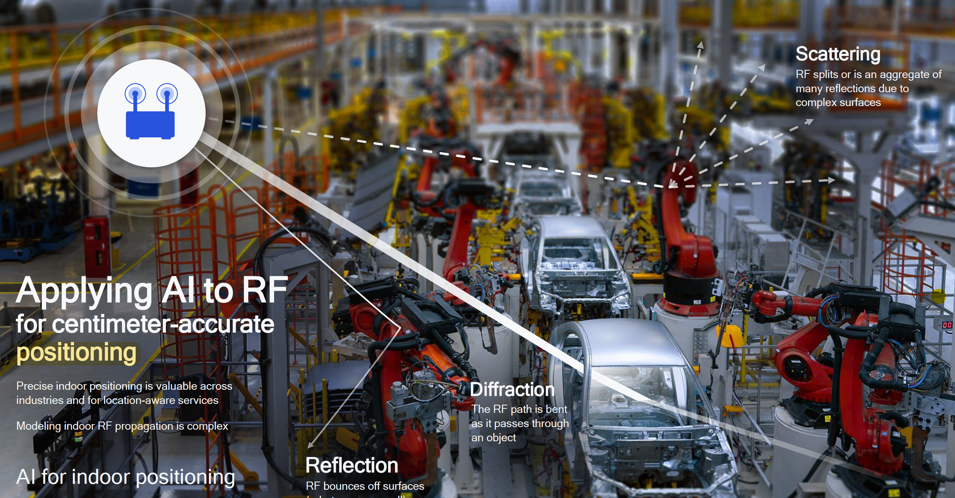
Section 3: Applications of Deep Learning Systems
Wireless Systems

Slide 21
What this course will teach you
Section 1: Introduction to Deep Neural Networks and Modern DNN Models.
- Convolutional Neural Networks
- Recurrent Neural Networks
Section 2: Building Modern Deep Learning Systems
- Efficient Deep Learning
- Automated Machine Learning and Neural Architecture Search
- Federated Learning
Section 3: Applications of Deep Learning Systems
- Deep Learning-based Video Analytics Systems
- Deep Learning-based Wireless Systems

Slide 22
Assignments
Paper reading reports and presentations (40%) - Individual
Paper reports
Paper presentations and discussions
Semester long project (60%) - Group
Select one of the provided topics
Propose an idea on what you want to do
Final presentation and demo

Slide 23
What this course will NOT teach you
Not teaching you linear algebra, probability, and statistics.
Not teaching you how to program with Python.
Not teaching you how to debug (We do NOT have a TA).
You have to learn how to use Google Colab / TensorFlow, how to code in Python, how to debug your code ALL by yourselves.

Slide 24
This is the first time this course is offered
COVID makes me to do home schooling, which takes a lot of time.
Lecture slides will not be perfect.
Lecture arrangement will not be perfect.
No programming assignments/practice (We do NOT have a TA to help).
May not be perfectly ready.
Next year should be much better.

